Slide 1
Budweiser Case Study
DS-6306 Ravi Sivaraman & Yves Hughes June 20th 2020
Notes:
The initial EDA presentation should be well polished as should the visual aids (example: PowerPoint deck)
Plots and Charts should be mentioned and/or referred to in the verbal presentation or they should not be in the deck.
Refrain from writing too much on the slides and / or overloading with information.
Use the information on the slides as an aid not a script. Points will be deducted for reading too much off of the slides.
Plots and Charts should be well labeled.
No code or screen shots of output.
Questions 1,3,4,5,6 and 7 should be fully addressed.
In general, points will be deducted for sloppiness and /or incompleteness.
Efforts that completely address each analysis question in an organized, clear and well supported manner will receive all or very near full credit.
Keep the presentation under 5 min.
The Initial EDA and Presentation is graded more on completeness rather than correctness. Your professor may give some direction or correction that they will look for in the final presentation.

Slide 2
Thank you
Notes:
Thank you for allowing us to present
* Make assumptions about what could be done with this EDA, perhaps make marketing or strategy decisions by state or changes distribution hubs

Slide 3
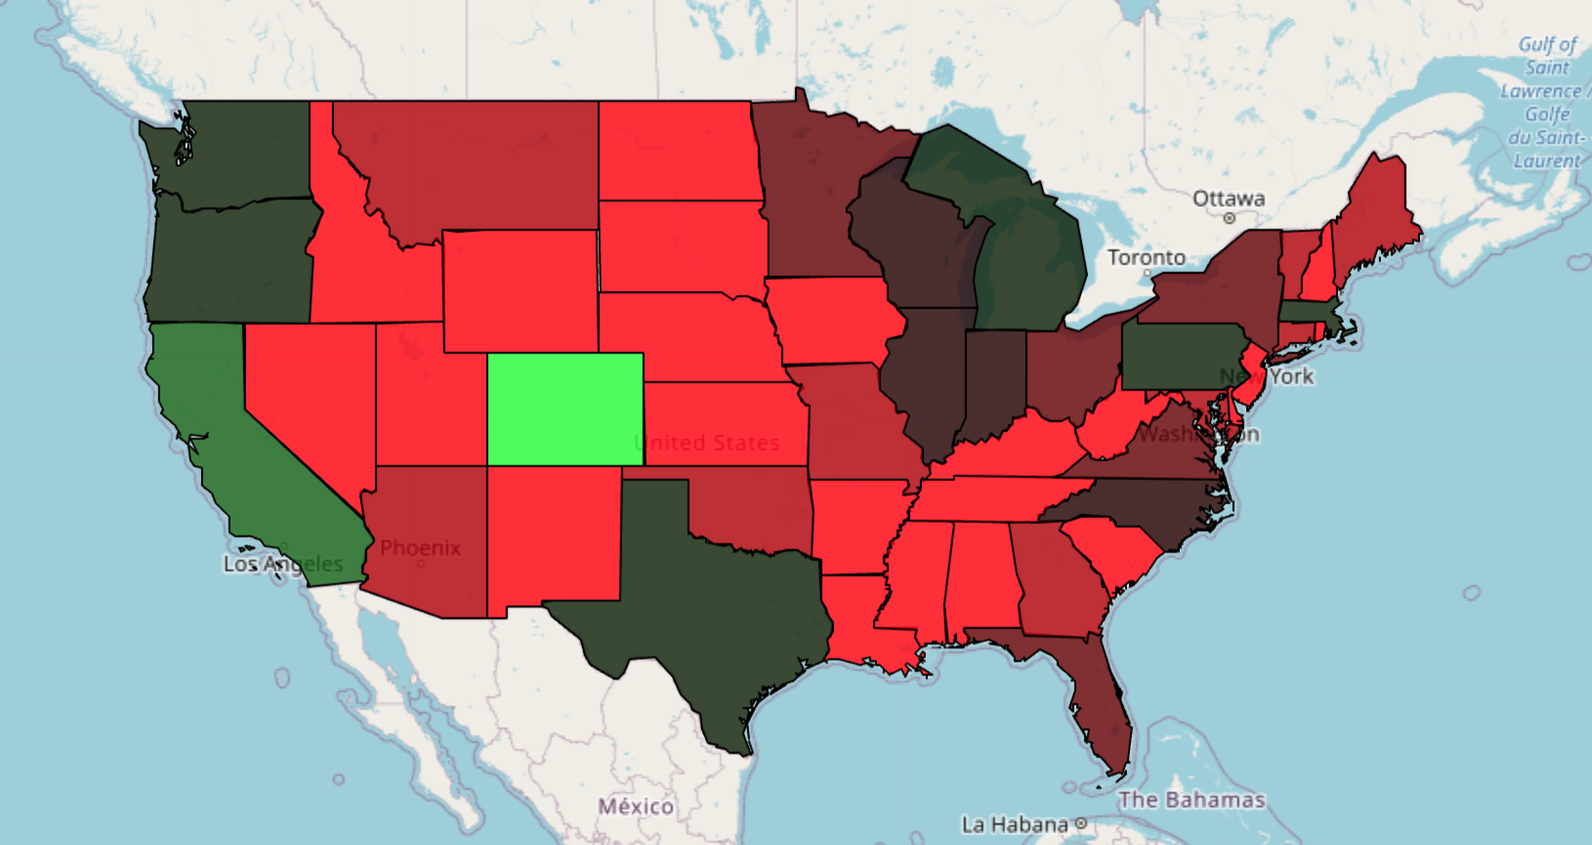
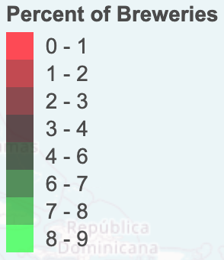
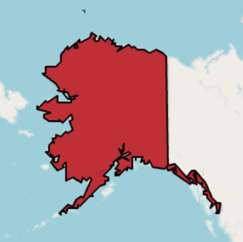

Breweries by State
State | No. of Breweries |  | State | No. of Breweries |  | State | No. of Breweries
CO | 47 |  | VA | 16 |  | GA | 7
CA | 39 |  | NY | 16 |  | AK | 7
MI | 32 |  | OH | 15 |  | OK | 6
OR | 29 |  | FL | 15 |  | RI | 5
TX | 28 |  | MN | 12 |  | NE | 5
PA | 25 |  | AZ | 11 |  | LA | 5
WA | 23 |  | VT | 10 |  | ID | 5
MA | 23 |  | MT | 9 |  | IA | 5
IN | 22 |  | MO | 9 |  | WY | 4
WI | 20 |  | ME | 9 |  | UT | 4
NC | 19 |  | CT | 8 |  | SC | 4
IL | 18 |  | MD | 7 |  | NM | 4
Notes:
1. How many breweries are present in each state?

Slide 4
“tidying up” the data
From the provided datasets there were 2,410 records. 1,005 were missing either IBU or ABV values so we populated these with their respective median.
Notes:
3. Address the missing values in each column.

Slide 5
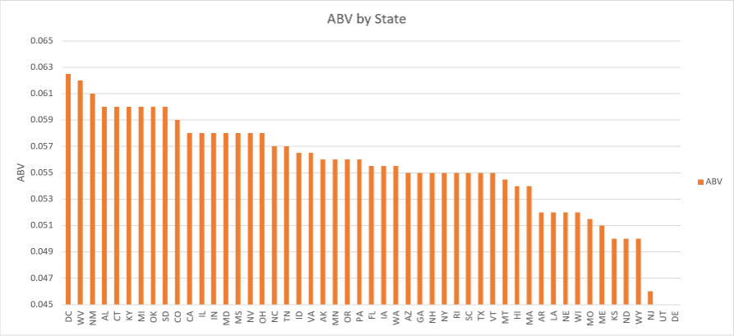
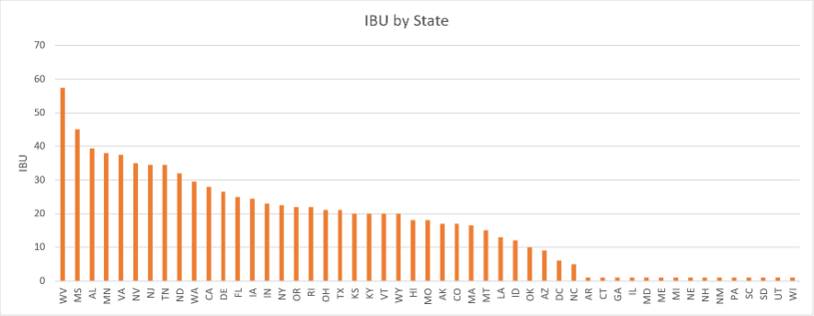
Alcohol Content vs IBU by State
Notes:
4. Compute the median alcohol content and international bitterness unit for each state. Plot a bar chart to compare.

Slide 6
Alcohol Content vs International Bitterness Unit
Colorado has the max ABV at 12.8%
Oregon has the max IBU at 138
Notes:
Which state has the maximum alcoholic (ABV) beer? Which state has the most bitter (IBU) beer?
California has minimum IBU and ABV at 0.01 and 4
> .09 .10
1 " AL" 1 1 " CO" 2
2 " AZ" 2 2 " IN" 1
3 " CA" 9 3 " KY" 1
4 " CO" 13
5 " DC" 1
6 " IA" 1
7 " ID" 3
8 " IL" 3
9 " IN" 7
10 " KY" 1
< .03
1 " CA" 1
2 " NH" 1
3 " NY" 1
4 " OR" 1

Slide 7
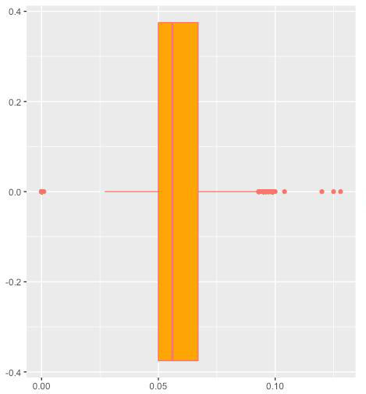
ABV Summary Statistics
Min | 25% | Median | Mean | 75% | Max
.001 | 0.05 | 0.056 | 0.058 | 0.067 | 0.128
Notes:
6. Comment on the summary statistics and distribution of the ABV variable.
A summary consists of five values: the most extreme values in the data set (the maximum and minimum values), the lower and upper quartiles, and the median. These values are presented together and ordered from lowest to highest: minimum value, lower quartile (Q₁), median value (Q₂), upper quartile (Q₃), maximum value.
Min. 1st Qu. Median Mean 3rd Qu. Max.
0.00000/0.001 0.05000 0.05600 0.05824 0.06700 0.12800
> .09 .10
1 " AL" 1 1 " CO" 2
2 " AZ" 2 2 " IN" 1
3 " CA" 9 3 " KY" 1
4 " CO" 13
5 " DC" 1
6 " IA" 1
7 " ID" 3
8 " IL" 3
9 " IN" 7
10 " KY" 1
< .03
1 " CA" 1
2 " NH" 1
3 " NY" 1
4 " OR" 1

Slide 8
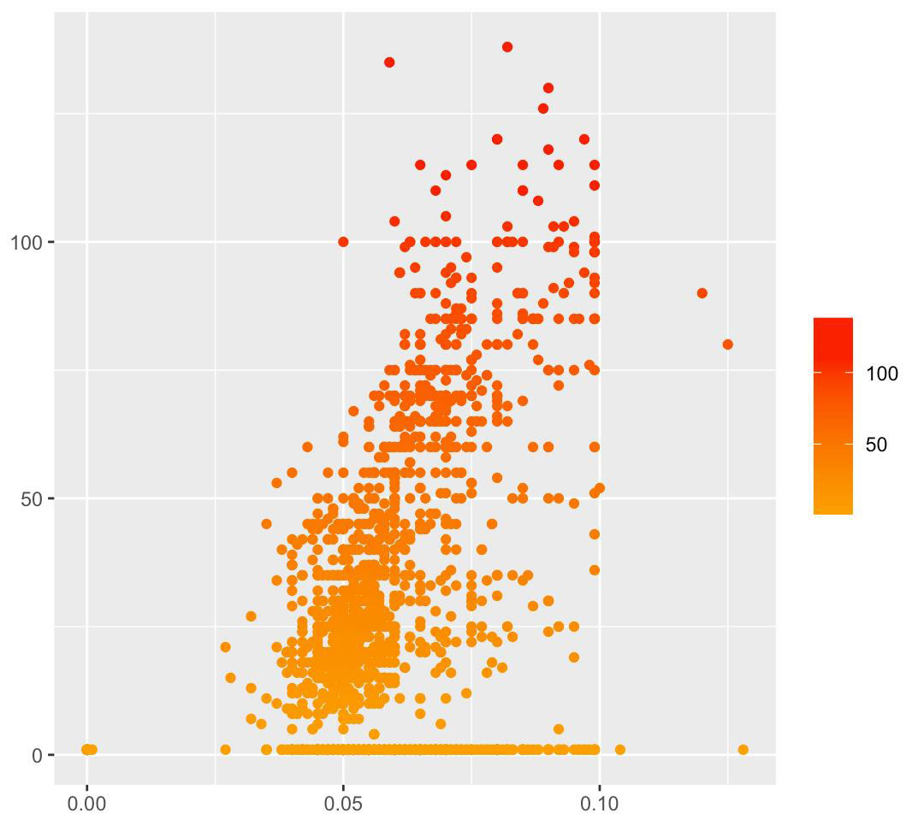
Bitterness & Alcoholic Content
IBU
ABV
Notes:
7. Is there an apparent relationship between the bitterness of the beer and its alcoholic content? Draw a scatter plot. Make your best judgment of a relationship and EXPLAIN your answer.
The low ABV has lower bitterness and the higher ABV has higher bitterness.

Slide 9
Thank you
Notes:
Thank you for allowing us to present

